Slide 1
Lesson objective
Title: Indices
Aim:
Be able to correctly state numbers with indices
Expand and simplify numbers with indices
Plan:
Daily review
  Terminology
  Substitution
Index notation

Slide 2
The word is
Pronumeral:
A letter or symbol used to represent a number.

Slide 3
The word is
Expression
Consists of numbers and pronumerals combined with any mathematical operations. (No equal sign)
When we do NOT know the value of the pronumeral, we cannot solve the expression… we leave the letter or symbol in
E.g., 2x + 6g – 9y + 12

Slide 4
The word is
Coefficient:
A number placed before a pronumeral.

Slide 5

Labels
$$2x+9f −10d$$
Coefficient
Pronumeral
Expression

Slide 6
Labels
$$2x+9f −10d$$
Coefficient
Pronumeral
Expression

Slide 7
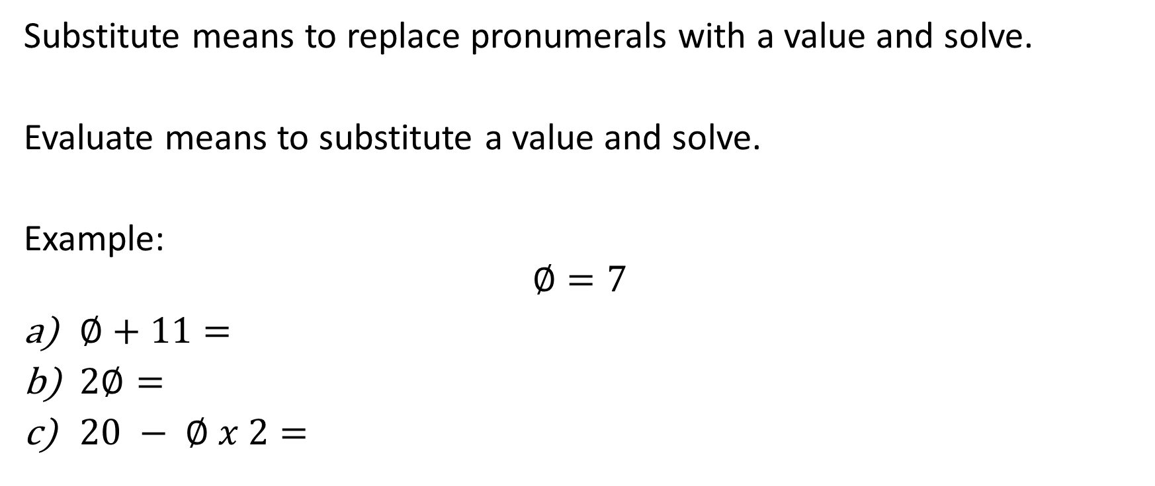
Reteach: Substitution
Substitute means to replace pronumerals with a value and solve.
Evaluate means to substitute a value and solve.
Example:
$$∅=7$$
$∅+11=$
$2∅=$
$20 − ∅ x 2=$

Slide 8
Exercise books
Evaluate by replacing the pronumeral with a value.
If x = 3, y = 4 and z = -2, evaluate:
x + y + z =
2x + 2z =
4y – x =
5y – z =
4z – 3x =

Slide 9
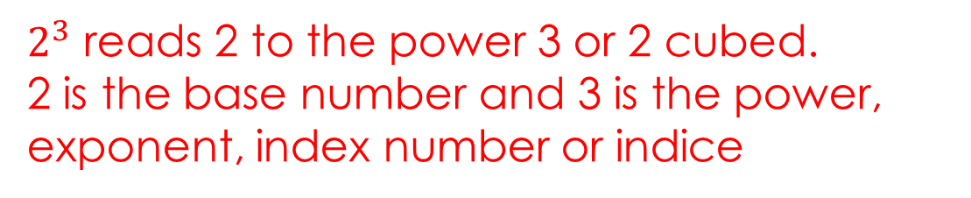
Indices
Index number
Power
Exponent
Index numbers are represented using superscript notation.
An index number cannot exist without a base number.
Powers indicate repeated multiplication of the same base number.
$2^{3}$ reads 2 to the power 3 or 2 cubed.
2 is the base number and 3 is the power, exponent, index number or indice
Notes:
Student guided notes 1

Slide 10
Indices
Index number
Power
Exponent
Index numbers are represented using superscript notation.
An index number cannot exist without a base number.
Powers indicate repeated multiplication of the same base number.
4 different expressions with the same meaning
$2^{3}$ reads 2 to the power 3 or 2 cubed.
2 is the base number and 3 is the power, exponent, index number or indice
Notes:
Student worksheet 1

Slide 11
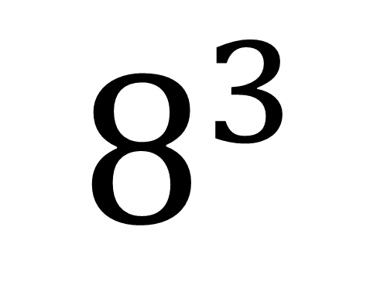
The index number
(or exponent, indices or power)
How many of the Base number we need in the multiplication
The BASE number
(BIG IS BASE)
It is the number that is repeated in the multiplication.
$$8^{3}$$
= 8 x 8 x 8
Notes:
Student guided notes 2

Slide 12
The index number
(or exponent, indices or power)
How many of the Base number we need in the multiplication
The BASE number
(BIG IS BASE)
It is the number that is repeated in the multiplication.
$$8^{3}$$
= 8 x 8 x 8

Slide 13

Indices: expanding and saying
Say and expand:
$5^{6}$
$9^{2}$
${10}^{5}$

Slide 14

Pair and share
To your partner just tell them how you would say:
$8^{4}$
$9^{5}$
$3^{2}$
$7^{20}$

Slide 15

Whiteboards
Expand the following
$8^{4}$
$9^{5}$
$3^{2}$
$7^{3}$

Slide 16
Simplifying to index notation
Count how many factors (repeats) of the base number
Write the base number large, and the number of factors small
4 x 4 x 4 x 4 x 4
2 x 2 x 2 x 2 x 2 x 2
10 x 10 x 10

Slide 17
Your turn – whiteboards
Simply (put into index notation)
7 x 7 x 7
2 x 2 x 2 x 2 x 2 x 2
4 x 4 x 4 x 4 x 4 x 4 x 4 x 4

Slide 18
Individual practice
Complete the Base and exponent task sheet.

Slide 19
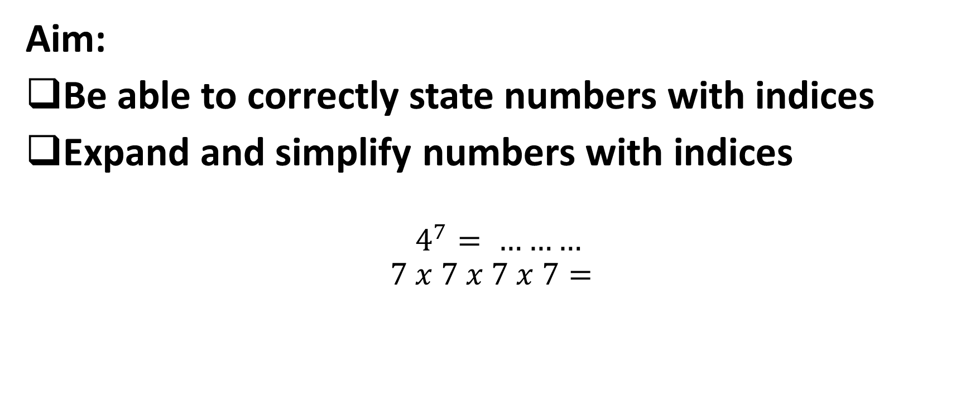
Reflection: fist to 5
Aim:
Be able to correctly state numbers with indices
Expand and simplify numbers with indices
$$4^{7}= ………$$
$$7 x 7 x 7 x 7=$$

Slide 20
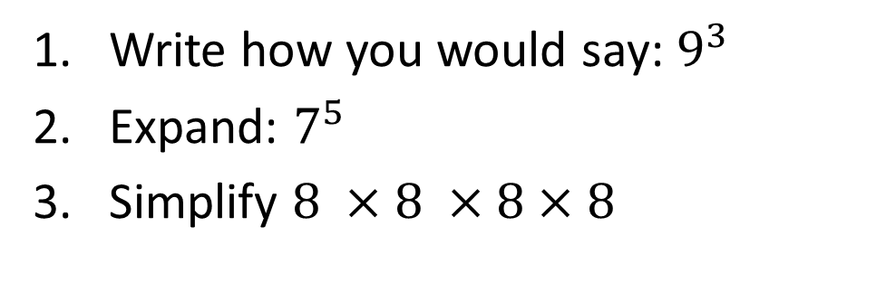
Hinge: whiteboards
Write how you would say: $9^{3}$
Expand: $7^{5}$
Simplify $8 ×8 ×8×8$

